Slide 1

Medical health records series
Project Contributor(s): Sabur Oladipupo BELLO

Slide 2
Problem Summary
This project seeks to examine the relationship Mr. John Hughes personal attributes on household expenses
This Dataset contains 1354 observations and 7 columns with variables including:
Dependent Variable:
Expenses
Independent Variables: consists of variables including:
Age
Sex
BMI
Children
Smoker
Region
Linear Regression, Multiple linear regression and plots will be used to examine the effect of Personal attributes on Expenses.
The attributes to be examined:
Effect of Smoking on Expenses
Effect of all input variables on Expenses

Slide 3
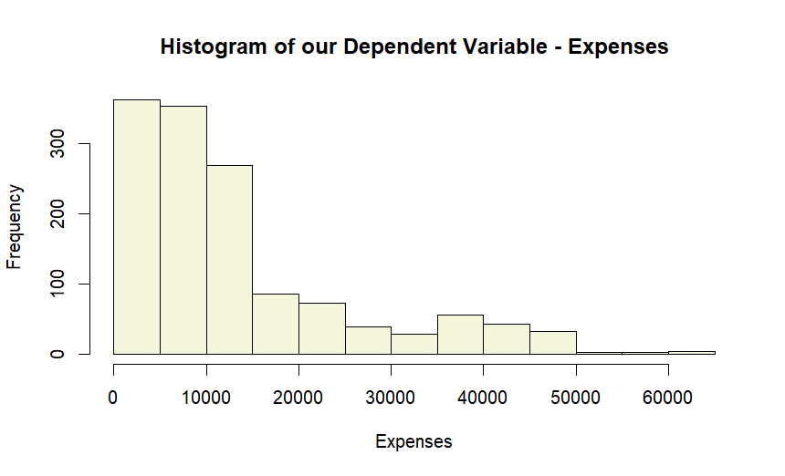
Histogram of the Dependent variable - expenses
Distribution
The distribution of Expenses has a Positive skew
Modality
The histogram is Unimodal
Central Tendency
This mean is largely greater than median mean (13409) > median (9413)
Insight
Bulk of population are closer to minimum expenses
Spread
Tail is on the right
Few larger values contribute to the higher mean

Slide 4
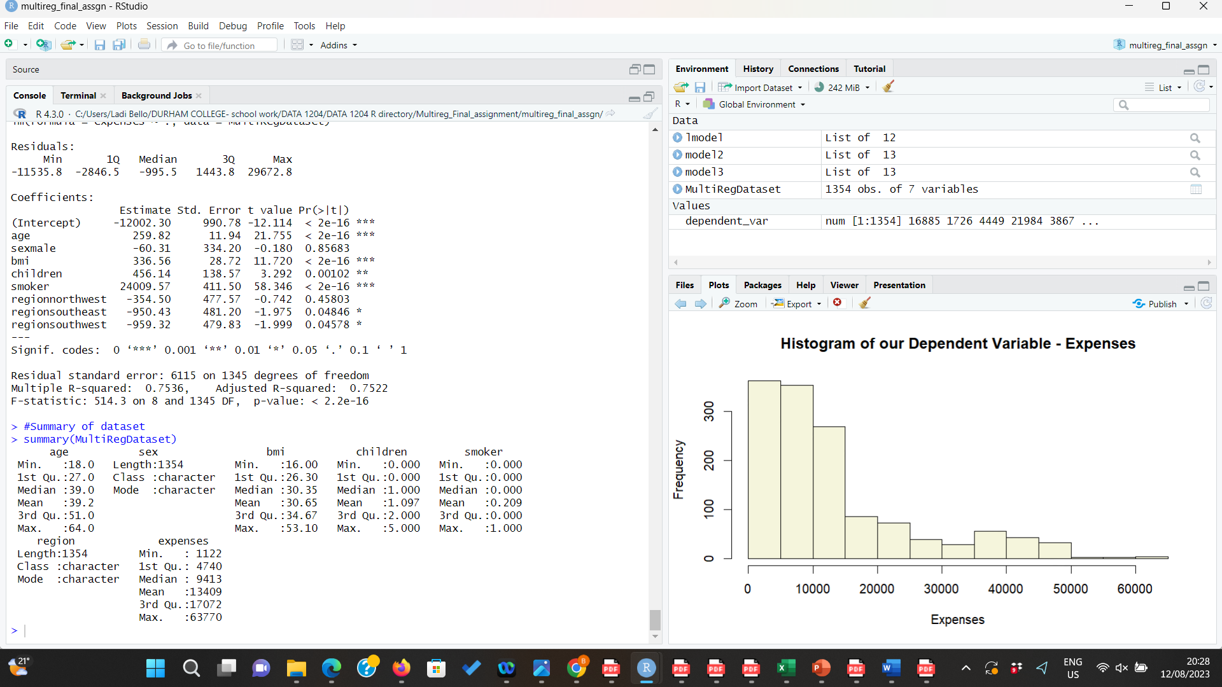
Insights from Basic Statistics
Mean vs Median
The variables in the dataset are skewed to the right
The mean of all the variables is slightly greater than the median
Minimum Value and First Quartile
Age Minvalue, bmi, and expenses have Minimum Value < First Quartile (Q1):
Suggests presence of Outliers in lower portion of the dataset
Expenses has the greatest spread (1122 < 4740)
Maximum Value and Upper Quartile
Suggests presence of Outliers in upper portion of the dataset
Expenses has the greatest spread

Slide 5
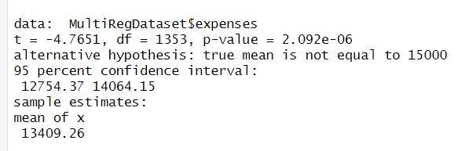
Hypothesis statement:
Null hypothesis H₀: µs = 15000
Alternative hypothesis Ha: µs ≠ 15000
T-value
T-value (-4.7651) is large
Supports alternate hypothesis
Degree of Freedom
High df, reliable distribution
Significance level (0.0.5)
Sample mean (13409), is significantly different
From hypothesized mean (15000)
Result
The results below show a p-value (2.092e-06)is less than the significance level 0.05.
Support the alternative hypothesis - “the true mean is not equal to 15000”.

Slide 6
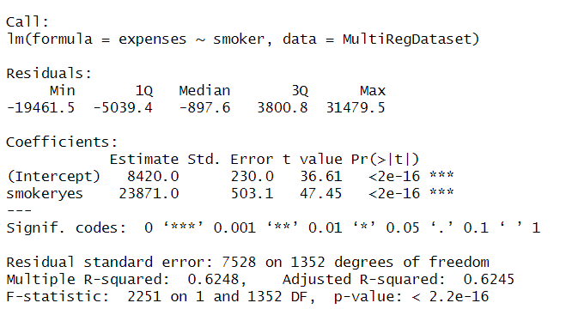
LINEAR REGRESSION
Equation for Regression Model
Y(smoker) = 8420+(23871)*X(expenses)
The R2 statistic is 62% and Error is 0.7528
P-value : < 2.2e-16
P-value less than significance value (0.05)
Correlation (0.7904212) – smoker and expenses
This is a strong positive correlation
Evaluation of the model Linear regression model is indeed statistically significant

Slide 7
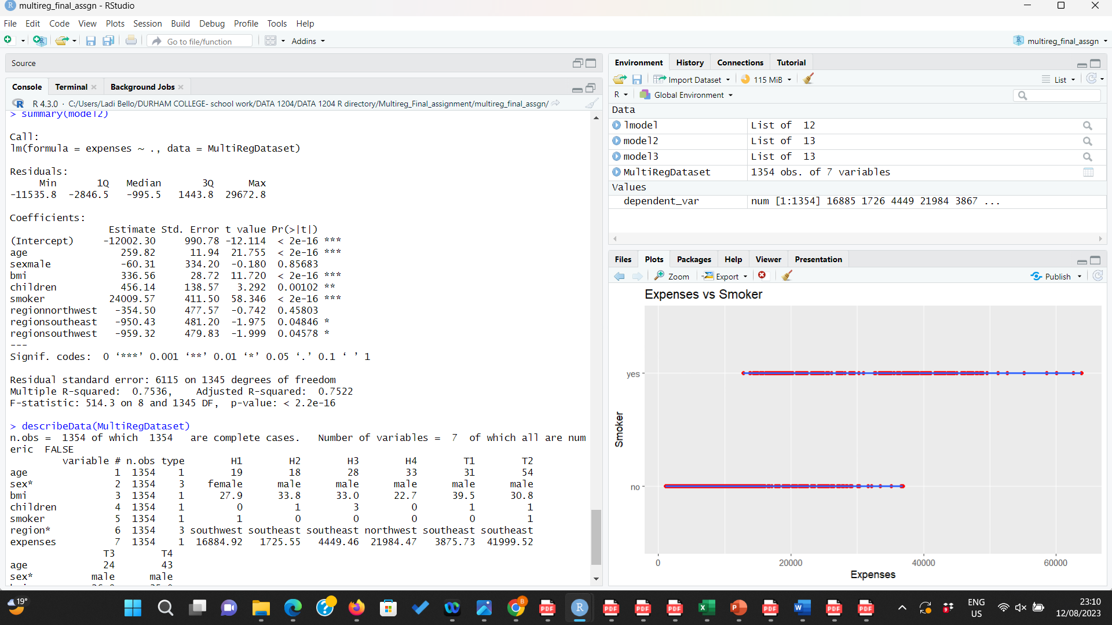
MULTIPLE REGRESSION
Equation for Regression Model
expenses=−12002.30+259.82×age−60.31×sexmale+
336.56×bmi+456.14×children+24009.57×smoker−
354.50×regionnorthwest−950.43×
regionsoutheast−959.32×regionsouthwest+ϵ
Age' has a positive coefficient of 259.82
Multiple R-squared' (0.7536) -75% prediction
Magnitude of error
Residual Standard Error (6115)
in the context of the dependent variable ('expenses’)
Evaluation of the model
The model is statistically significant as a whole -
'F-statistic' (514.3) and p-value (p < 2.2e-16)

Slide 8
CONCLUSION
Linear Regression
The model is statistically significant and explains a considerable portion of the variability in 'expenses’.
The low p-values (2.2e-16) for both the intercept and the 'smoker' coefficient suggest strong evidence of their influence on the response variable.
Multiple Regression
The model seems to provide a good fit to the data, as evidenced by the significant F-statistic (p_value < 2.2e-16) and Adjusted R-squared (75.22%) value.
However, careful consideration should be given to the significance of individual predictors and their practical implications.

Slide 9
Thank you!

